Slide 1
Equitable Investment Team
Tim, Mark, Carla, Daniel, Tammi, Heather
Notes:
This presentation demonstrates the new capabilities of PowerPoint and it is best viewed in Slide Show. These slides are designed to give you great ideas for the presentations you’ll create in PowerPoint 2010!
For more sample templates, click the File tab, and then on the New tab, click Sample Templates.

Slide 2
TEAM EIT
Carla Mays – mays.carla@gmail.com
Tammy Ernst – TammyKErnst@yahoo.com
Mark Llorente – markcatalysis@gmail.com
Daniel Edmond – dxedmond@gmail.com
Tim Child – tim.child@comcast.com
Heather Madison – madisse@yahoo.com

Slide 3
PROBLEM
Lack a platform to connect investors in clean energy to communities of need in Myanmar equitably and sustainably.

Slide 4
Solution: Fintech Platform
Fintech Platform for Equitable Investment
Enables Impact Investment Decisions to be maximized and to maximize ROI
Key Features:
Architecture is cloud based and scalable
Strategic
Identify Investment Need Based on Criteria:
Country, City, Township
Models: Pricing, Population, Governance

Slide 5
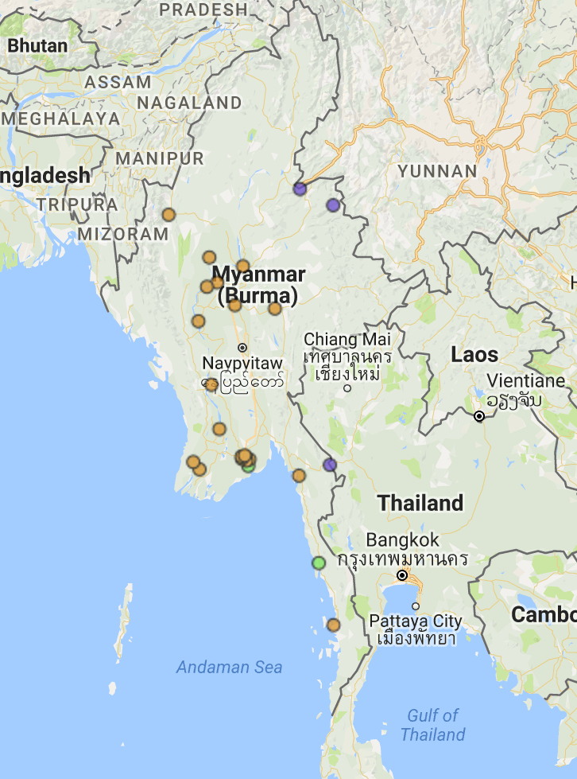
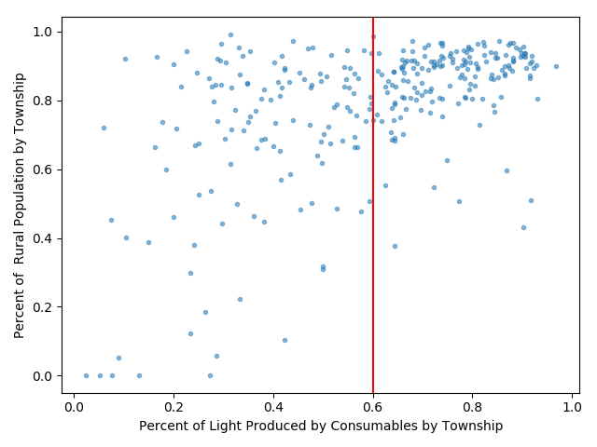
Investment Mapping: Selecting Target Townships
Initial locations selected by regions near high economic activity but dependent on consumable fuels.
PV system chosen by density and number of households, estimated cost and ROI evaluated.
Success at initial sites fed back into model.

Slide 6
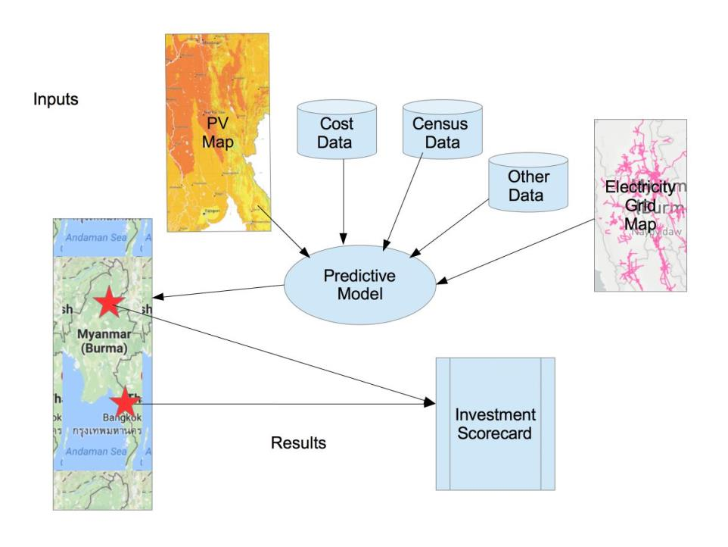
Product Overview

Slide 7
Recommendations
Max score selection for targeting townships
Start small scale to gather real data and add success rates to feed back into predictive model.
Survey improvements in access to education, refrigeration, health; indirect improvements.
New Features

Slide 8
Thank you!

